Slide 1
STM 0.1 Saccom Transport Management
User Guide
Created by YASSINE BAGHDADI
with help of ANASS KADA
and SACCOM IT TEAM

Slide 2
What is STM?
STM 0.1 or SACCOM TRANSPORT MANAGEMENT is an Solution to manage the transport plans and avoid the Disorganized management, STM consist of two applications :
STM-Mobile : Mobile Application work in android, for the drivers.
STM-Desktop : Portable Desktop Application (no installation needed) for the Admin.

Slide 3
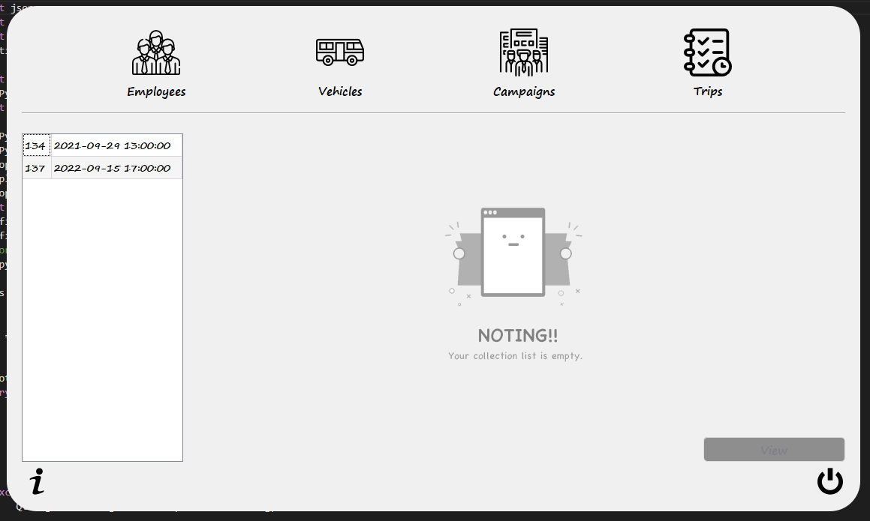
How it Works? Part 1
The Prosses starting from the admin side (Desktop app) :
Page 1 : Main page
All Trips
Employees List
Vehicles List
Groupes List
**
Coming Trips List *
* ➔ the trips the not yet done sorted by Date/Time From newer to older .
** ➔ No thing to show until click on some trip to see it’s info .

Slide 4
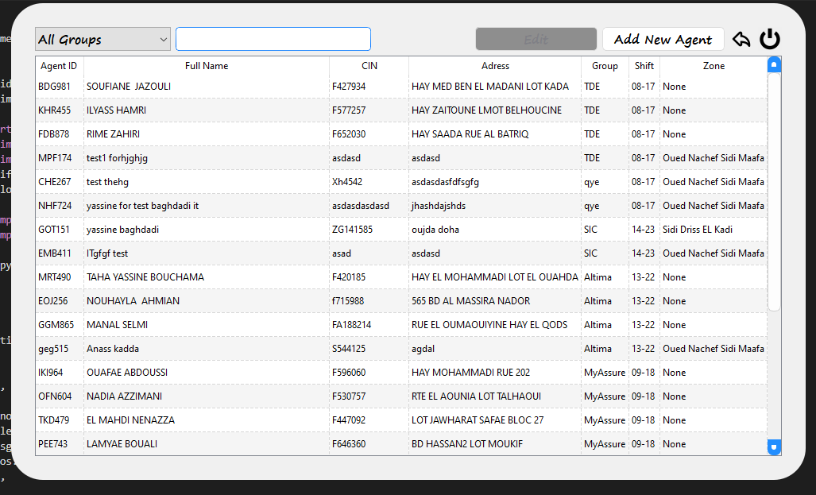
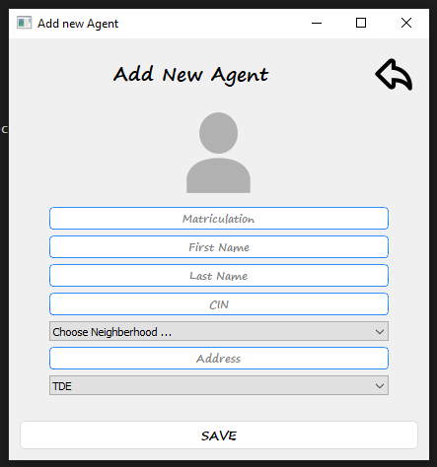
How it Works? Part 2
1
To Insert a 3D Model:
Agents/Employees List :
Filter Agents by Groups .
Search for Agent by Name or CIN or Matriculation …
Edit Agent by select the agent and click EDIT button.
Add new Agent :
Fill all the information (all info required) ,
Click at the picture to choose Picture for the agent ,
1
2
2

Slide 5
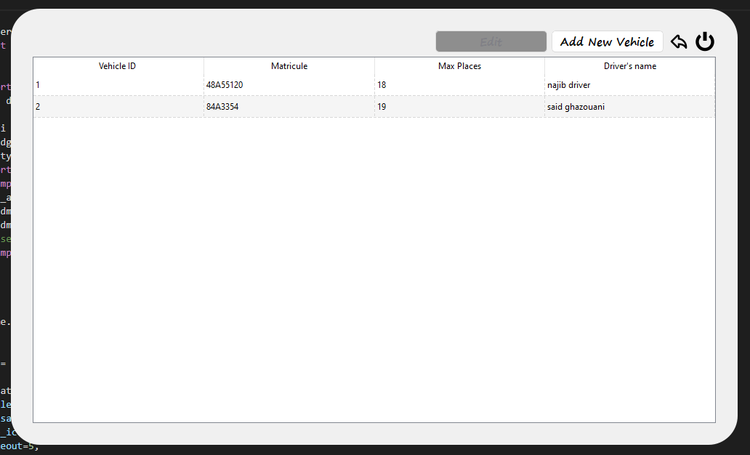
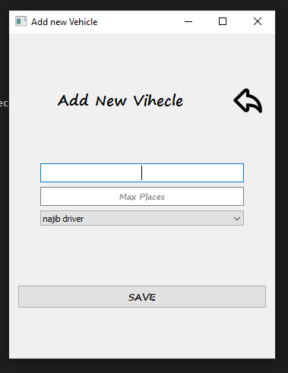
How it Works? Part 3
1
1
Vehicles Page :
View infos about all the Vehicles.
Modify by select the vehicle and click Edit.
Add new vehicle .
2
2
Add new vehicle Page :
Fill allthe infos and choose driver for this new vehicle

Slide 6
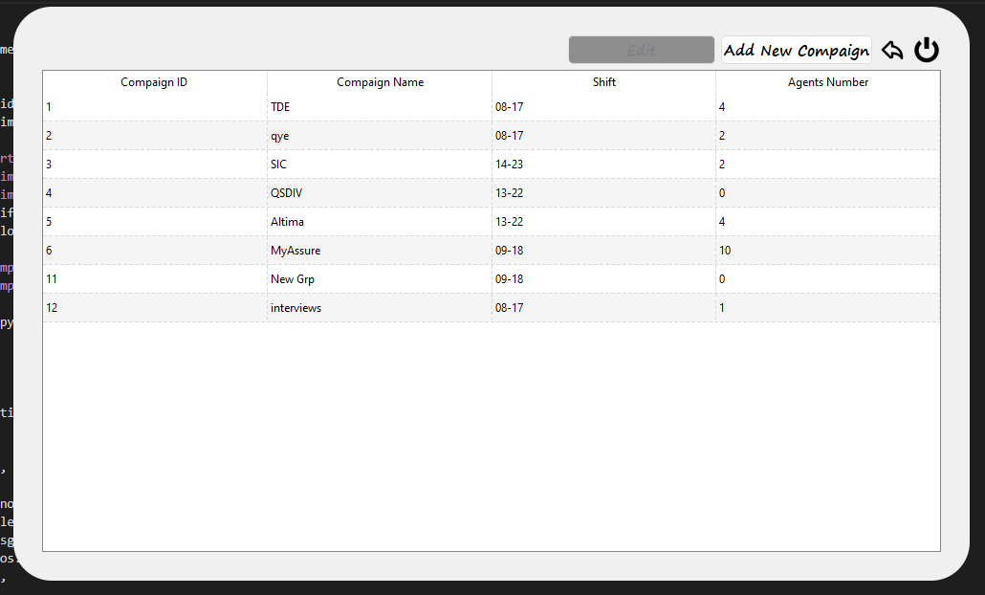
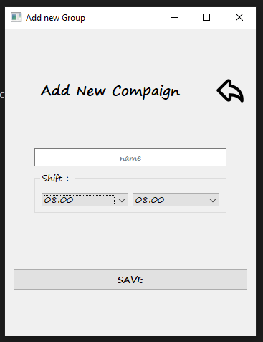
How it Works? Part 4
1
Try them yourself with the parrot on the right:
1
Campaigns/Groups Page :
View name and schedual of all groups
2
Add new Group Page :
Fill the info and choose the Shift By specify the enter and leaving time (should be 9 hours between the two times )
2

Slide 7
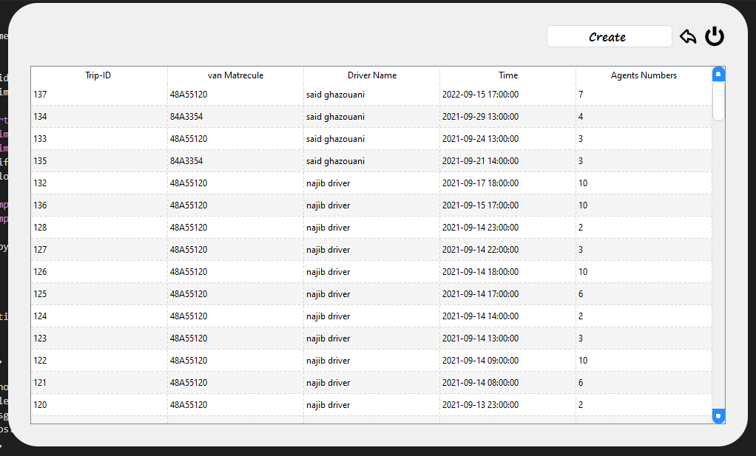
How it Works? Part 5
All trips page :
You can create new trips by clicking on Create .
View details about a trip by double click on it .

Slide 8
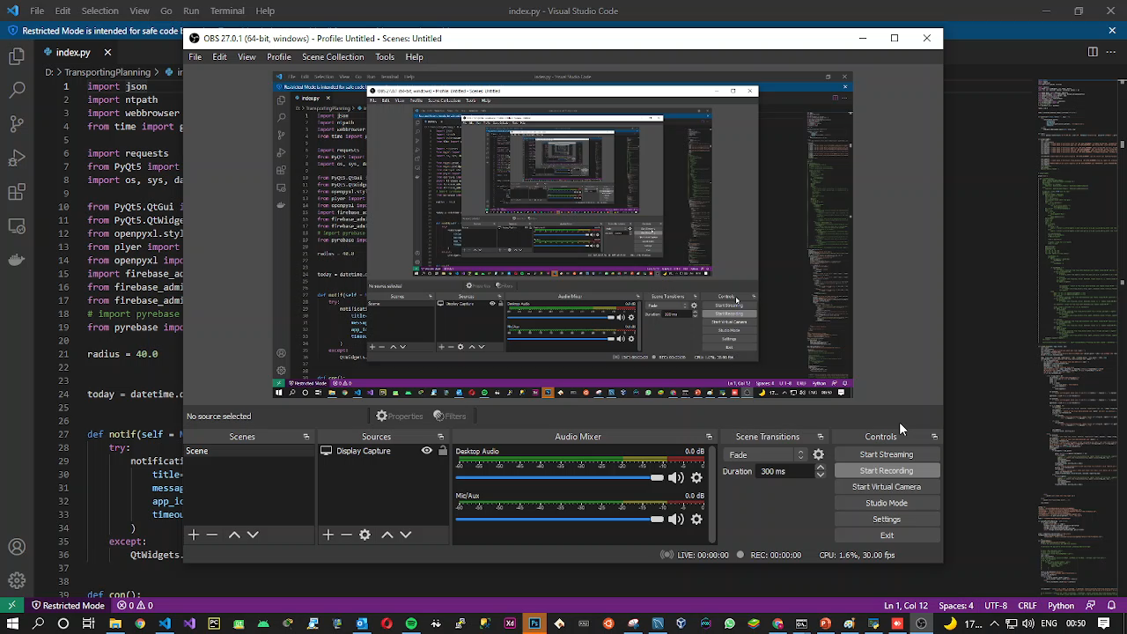
How it Works? Part 5-1
Trip View Page :
If Date and Time of trip are valid you can add or remove Agents from that trip .
You can click on Start time to get started location and the same for the stop .
If the Trip already done you can click at view and see the full path of the trip on google maps as the video shows.

Slide 9
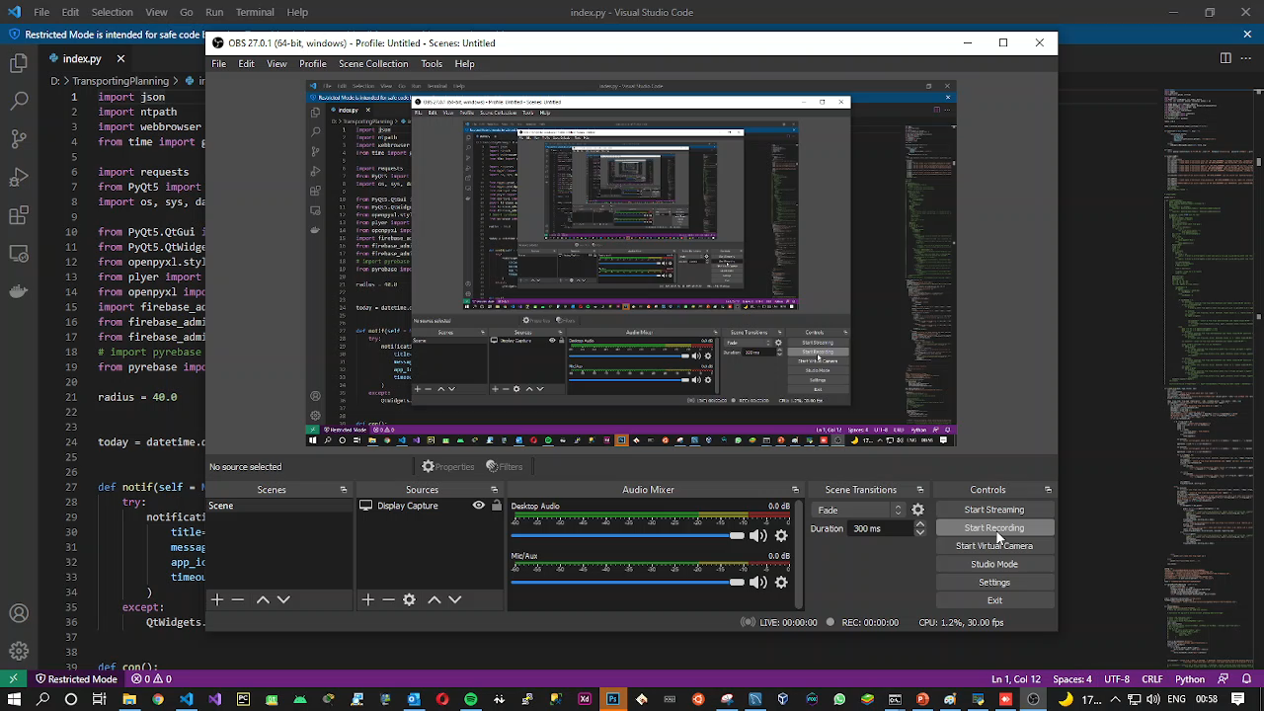
How it Works? Part 5-2
Trip View Page :
Click Export and get a excel file ready to print by the names of agents for that trip (see the video).

Slide 10
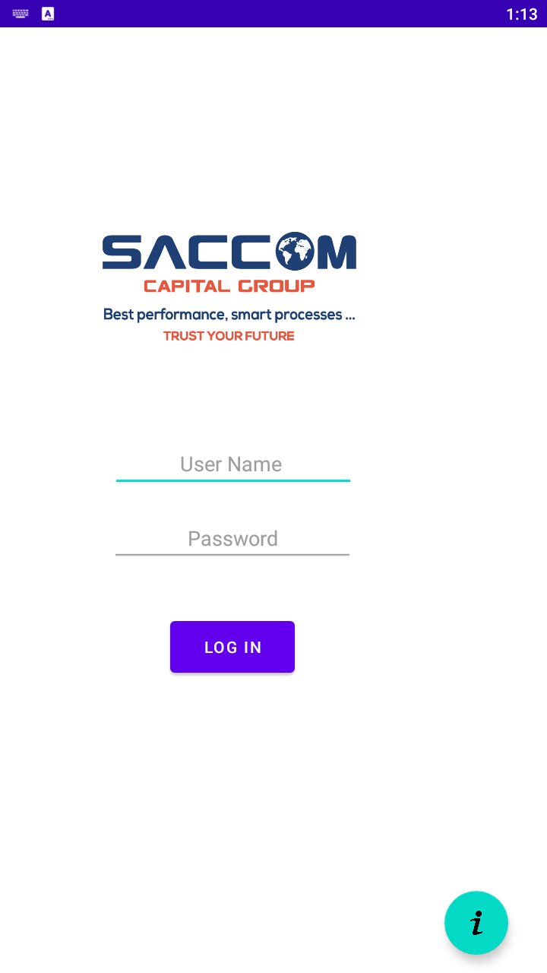
How it work ? Part 6
The Prosses starting from the Driver side (Mobile app) :
1
First thing is to give GPS and Calls Permissions to the apps without them can’t run properly.
GPS : to get trip path and driver’s current location.
Calls : to call the agent directly from the app .
1
Login Page with simple UI that you can access the app
rough by the correct username and password

Slide 11
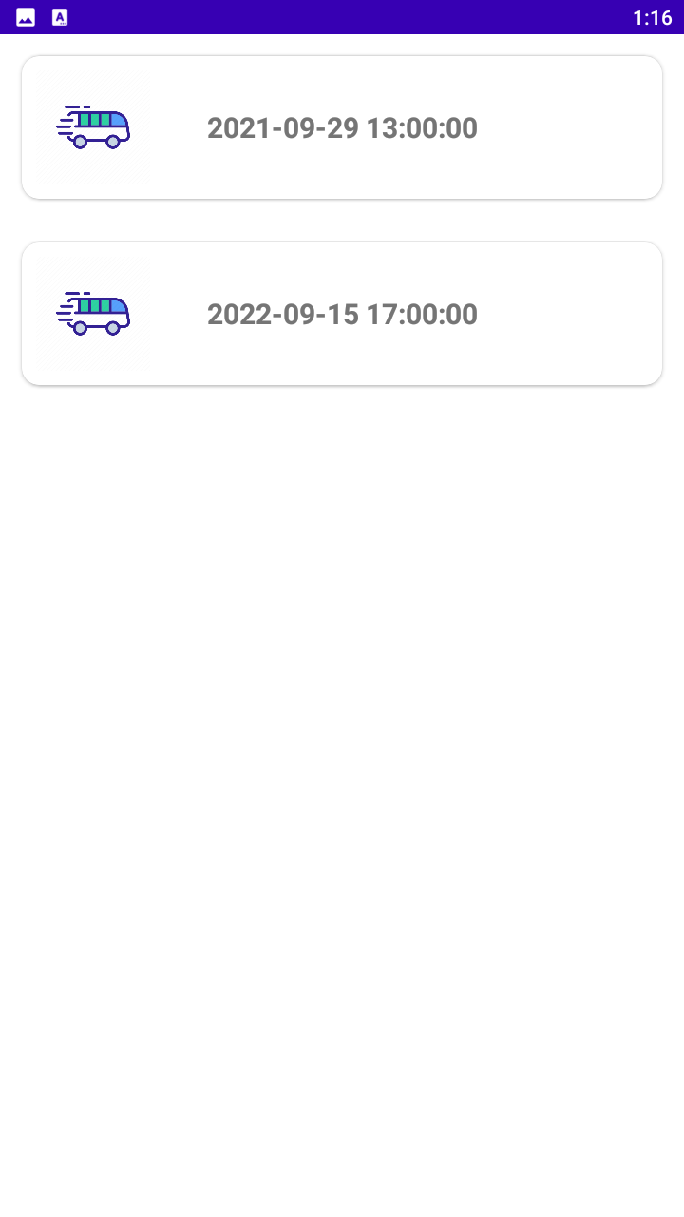
How it work ? Part 6
1
Trips list Page :
Shows the available Trip that you have as driver .
1
➔ When you choose a trip you’ll get an popped up page telling you if you want to start the trip or just see the agents ,
For start it you have to provide the current KM in the vehicle counter (you can’t start a new trip
if there is atrip started before),when the trip start you can change agent status :
Enter : enter the vehicle, the app getting the time and location.
Leave : Leave the vehicle, the app getting the time and the location.
Absent : if the agent is absent.
Call : to call the agent in case didn’t came at the time.
**see the video of simulation in the next slide …

Slide 12
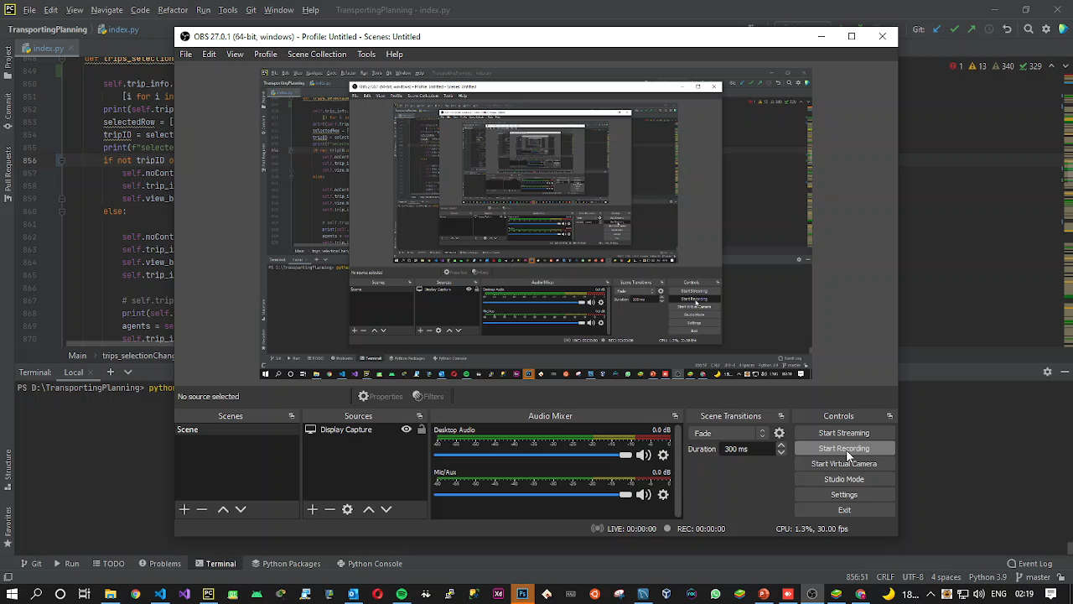
How it Works ? Part 7 Simulation .

Slide 13
More Infos about STM Project?
Used techs :
Desktop App (Admin side ):
Python : Pyqt5, pymysql, firebase_admin, plyer, openpyxl, selenium, requests, qt
C++ : QT compiler .
Mobile App (driver side):
Android studio : JAVA, XML
Yassine Baghdadi ➔ https://yassinebaghdadi.github.io/

